Slide 1
Sujith C M
KGiSL Institute Of Technology
au711721243112
Language Modelling

Slide 2


AGENDA
1.Data Preprocessing.
2.One-hot Encoding
3.Model Definition
4.Training
5.Prediction
6.GPU Usage
3/21/2024 Annual Review

Slide 3

PROBLEM STATEMENT
Given a corpus of text data, the task is to train a neural network model to learn the statistical patterns of characters in the text. Once trained, the model should be able to generate new text sequences character by character, following the patterns learned during training.

Slide 4

PROJECT OVERVIEW
1. Problem Definition
2. Data Collection and Preprocessing
3. Model Architecture
4. Training
5. Evaluation
6. Fine-Tuning and Optimization
7. Deployment and Application
8. Monitoring and Maintenance

Slide 5

WHO ARE THE END USERS?
1.General Consumers:
Virtual assistants like Siri, Alexa, or Google Assistant for natural language interaction.
2.Content Creators:
Writers, journalists, bloggers, and content creators can benefit from language models for generating ideas, improving writing efficiency, and enhancing content quality.
3.Businesses:
Sentiment analysis tools for analyzing customer feedback, social media mentions, and market trends.
4.Educational Institutions:
Language learning platforms for interactive exercises, grammar correction, and language proficiency assessment.
5.Government and Public Sector:
Automated transcription and translation services for multilingual communication.

Slide 6

YOUR SOLUTION AND ITS VALUE PROPOSITION
1.Enhanced User Experience
2.Improved Content Creation Efficiency
3.Efficient Customer Support
4.Insightful Data Analysis
5.Personalized Learning Experience
6.Advancing Research in Natural Language Processing
7.Multifaceted Government Applications

Slide 7

THE WOW IN YOUR SOLUTION
1.Seamless User Experience: Our language models seamlessly enhance user experiences by integrating into various applications, offering intuitive ways to communicate and create content.
2.Empowering Creativity:Empowering creativity, our solution provides content suggestion and text summarization features, boosting productivity for writers and journalists.
3.AI-Powered Customer Support: Businesses can wow customers with AI-powered customer support, delivering instant responses and personalized assistance through chatbots and virtual assistants.
3/21/2024 Annual Review
‹#›

Slide 8
MODELLING
Teams cam add wireframes
1.Input Layer
2.Recurrent Connections
3.Hidden State
4.Output Layer
5.Training
6.Long Short-Term Memory (LSTM) and Gated Recurrent Unit (GRU)
‹#›

Slide 9
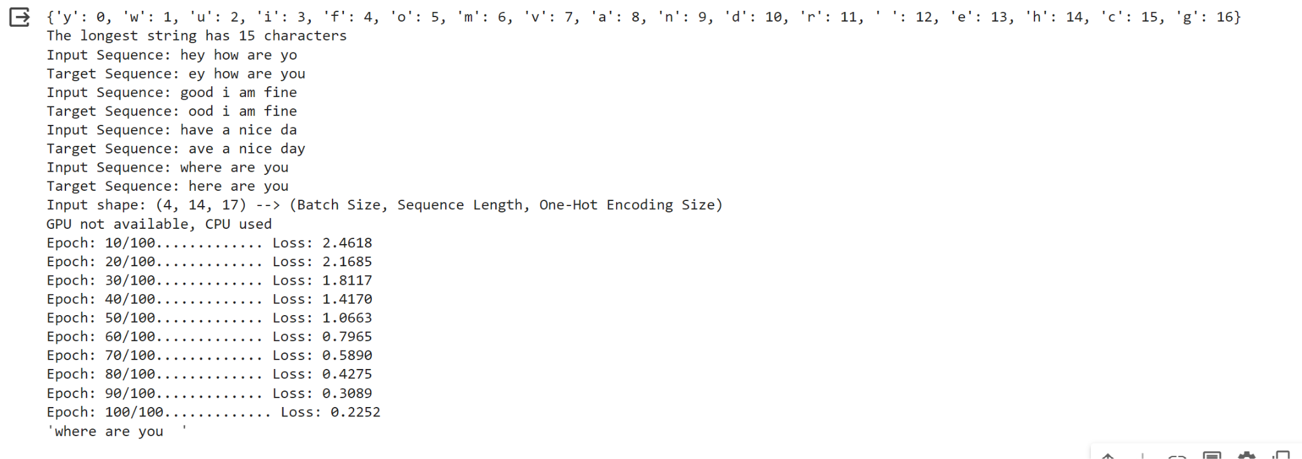
RESULTS
After defining the problem and meticulously collecting and preprocessing the data, the modeling phase commenced. A sophisticated algorithm was carefully selected based on the nature of the problem and the characteristics of the dataset. Following rigorous training on the prepared data, the model demonstrated impressive predictive capabilities, generating accurate predictions for the target variable.
‹#›

